Slide 1
Unit -1
Lecture - 1
INTRODUCTION
of
( computer networks and Types of Networks ) .

Slide 2
What is computer network?
Computer networking define as interconnected computing devices that can perform to exchange data and share resources with each other.
These networked devices use a system of rules, called communications protocols, to transmit information over physical or wireless technologies.

Slide 3
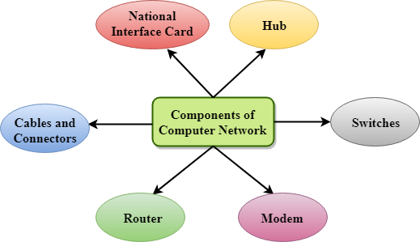
What are Components of components of computer networks ?

Slide 4
Computer network component explanation .
NIC
NIC stands for network interface card.
NIC is a hardware component used to connect a computer with another computer onto a network
It can support a transfer rate of 10,100 to 1000 Mb/s.
The MAC address or physical address is encoded on the network card chip which is assigned by the IEEE to identify a network card uniquely. The MAC address is stored in the PROM (Programmable read-only memory).

Slide 5
definition of two types of NIC and hub-
Wired NIC: The Wired NIC is present inside the motherboard. Cables and connectors are used with wired NIC to transfer data.
Wireless NIC: The wireless NIC contains the antenna to obtain the connection over the wireless network. For example, laptop computer contains the wireless NIC.
Hub
A Hub is a hardware device that divides the network connection among multiple devices. When computer requests for some information from a network, it first sends the request to the Hub through cable. Hub will broadcast this request to the entire network. All the devices will check whether the request belongs to them or not. If not, the request will be dropped.

Slide 6
Cables and Connectors.
Cable is a transmission media used for transmitting a signal.
There are three types of cables used in transmission:
Twisted pair cable
Coaxial cable
Fibre-optic cable
Modem-
A modem is a hardware device that allows the computer to connect to the internet over the existing telephone line. It stands for Modulator/Demodulator. It converts the digital data into an analog signal over the telephone lines.

Slide 7
Component of computer networks .
Switch -
A switch is a hardware device that connects multiple devices on a computer network. A Switch contains more advanced features than Hub. The Switch contains the updated table that decides where the data is transmitted or not. Switch delivers the message to the correct destination based on the physical address present in the incoming message.
Router
A router is a hardware device which is used to connect a LAN with an internet connection. It is used to receive, analyze and forward the incoming packets to another network.
A router works in a Layer 3 (Network layer) of the OSI Reference model.

Slide 8
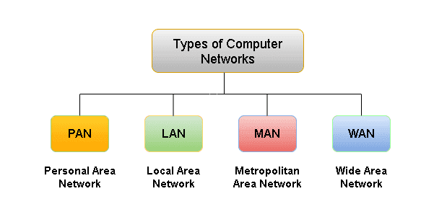
Types of computer networks .

Slide 9
Types of computer networks with examples .
Personal Area Network (PAN)
PAN is the most basic type of computer network. This network is restrained to a single person, that is, communication between the computer devices is centered only on an individual’s workspace. PAN offers a network range of 1 to 100 meters from person to device providing communication. Its transmission speed is very high with very easy maintenance and very low cost.
Examples of PAN are USB, computer, phone, tablet, printer, PDA, etc.
Local Area Network (LAN)
LAN is the most frequently used network. A LAN is a computer network that connects computers through a common communication path, contained within a limited area, that is, locally. Examples of LAN are networking in a home, school, library, laboratory, college, office, etc.

Slide 10
Metropolitan Area Network (MAN)
It is a type of computer network that connects computers over a geographical distance through a shared communication path over a city, town, or metropolitan area. Its range is from 5km to 50km. Its transmission speed is average. It is difficult to maintain and it comes with a high cost.
Examples of MAN are networking in towns, cities, a single large city, a large area within multiple buildings, etc.
Wide Area Network (WAN)
WAN is a type of computer network that connects computers over a large geographical distance through a shared communication path.
The most common example of WAN is the Internet.

Slide 11
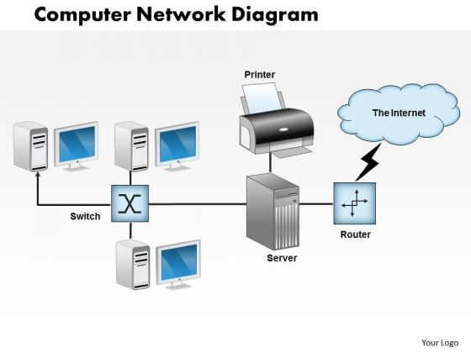
Diagram of computer network .

Slide 12
What are the examples of cn ?
Some examples of computer networks are the following:
LANs. LANs interconnect endpoints in a single domain. Examples of LANs include schools, hospitals and office buildings.
WANs. WANs interconnect multiple LANs and span larger geographical areas, such as big cities, states and countries.
Metropolitan area networks (MANs). A MAN connects computer resources in a large geographic area, such as a city.
Storage area networks (SANs). SANs are specialized and dedicated networks that connect multiple high-performance data storage devices and resources. They provide built-in security and block-level access.
A SAN provides disaster recovery because it includes different storage devices, such as disk drives, magnetic tapes and optical storage.
Personal area networks (PANs). A PAN is used by one person to connect multiple devices, such as printers and scanners.

Slide 13
Advantages of using a computer network.
These are the following are benefits of using a computer network:
Resource sharing. Enterprises of all sizes can use a computer network to share resources and critical assets. Resources for sharing can include printers, files, scanners and photocopy machines. Computer networks are especially beneficial for larger and globally spread-out organizations, as they can use a single common network to connect with their employees.
Flexibility. Today's computer networks enable people to use flexible communication and resource-sharing methods based on their needs and preferences. For example, some people might use email or instant messaging to communicate, while others might prefer using an app such as WhatsApp.
Higher connectivity. Thanks to computer networks, people can stay connected regardless of their location. For example, video calling and document-sharing apps, such as Zoom and Google Docs, enable employees to connect and collaborate remotely.

Slide 14
What is DATA COMMUNICATIONS ?
The term telecommunication means communication at a distance. The word data refers to information presented in whatever form is agreed upon by the parties creating and using the data.
Data communications are the exchange of data between two devices via some form of transmission medium such as a wire cable or may be wireless.

Slide 15
Effectiveness of Data Communication.
Four Fundamental Characteristics
Delivery
Accuracy
Timeliness - -real time
Jitter

Slide 16
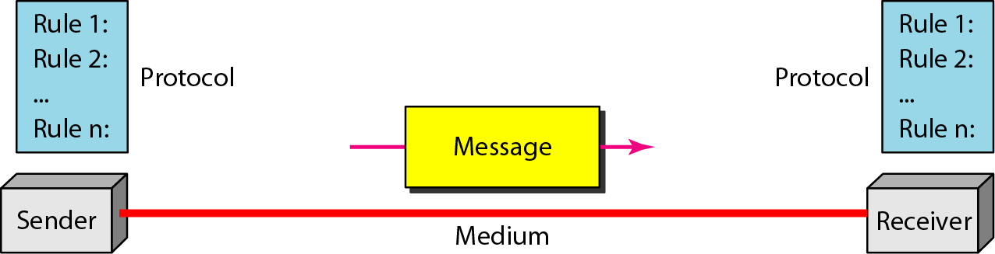
Components of a Data Communication System .

Slide 17
Different components of data communication .
Five Components:
Message- Text, Number, Image, Audio, Video
Sender
Receiver
Transmission Medium
Protocol

Slide 18
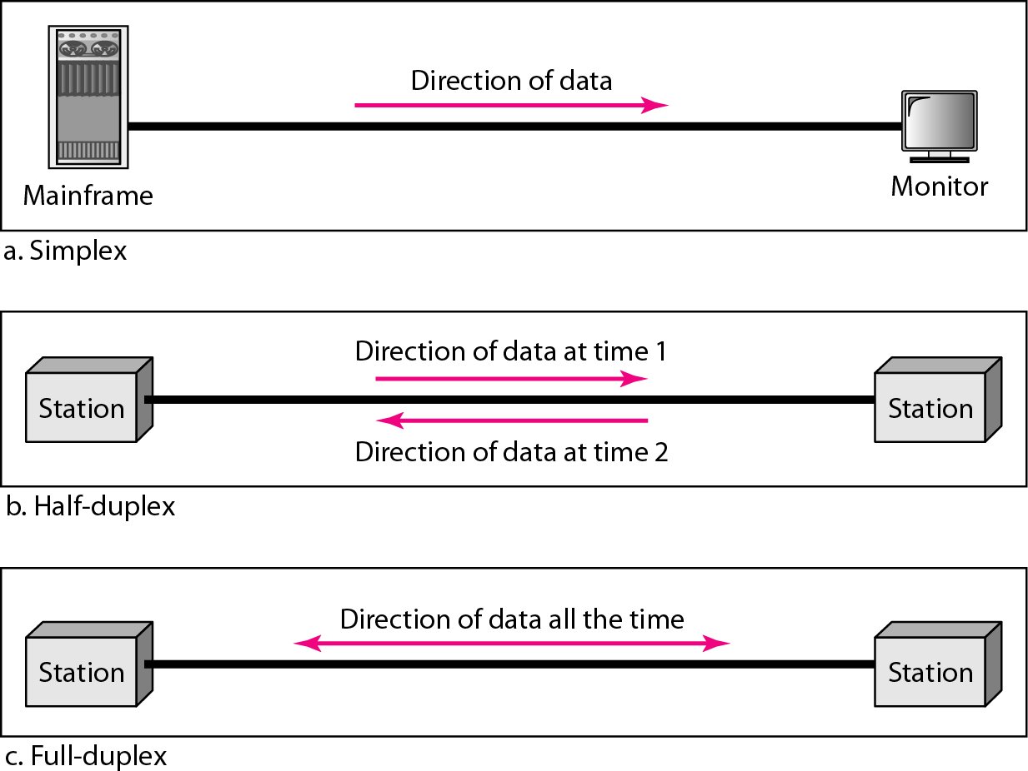
Data flow (Simplex, Half-duplex, and Full-duplex) .

Slide 19
NETWORKS
A network is a set of devices (often referred to as nodes) connected by communication links. A node can be a computer, printer, or any other device capable of sending and/or receiving data generated by other nodes on the network.
A link can be a cable, air, optical fiber, or any medium which can transport a signal carrying information.

Slide 20
Network Criteria.
Performance
Depends on Network Elements- Transmit time, Response Time, Number of users, type of transmission medium, hardware, software.
Measured in terms of Delay and Throughput
Reliability
Failure rate of network components.
Time to recover from a failure.
Measured in terms of availability/robustness
Security
Data protection against corruption/loss of data due to:
Errors
Malicious users/ Unauthorized access.

Slide 21
Physical Structures.
Type of Connection
Point to Point - single transmitter and receiver
Multipoint - multiple recipients of single transmission
Physical Topology
Connection of devices
Type of transmission - unicast, mulitcast, broadcast

Slide 22
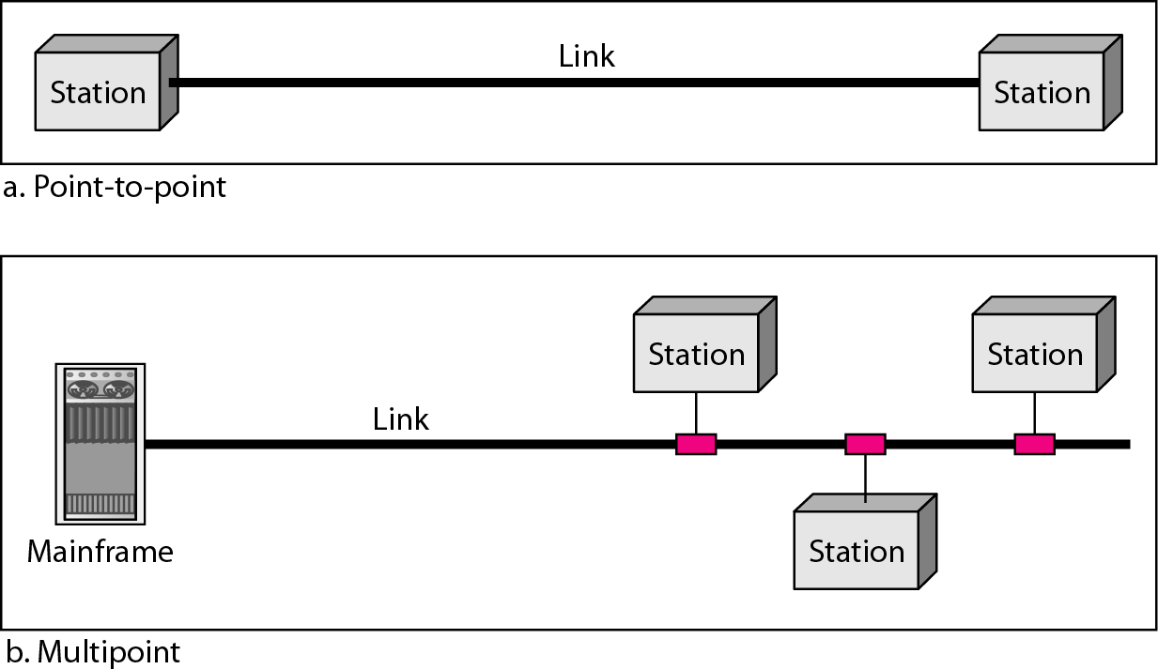
Types of connections: point-to-point and multipoint.

Slide 23
Uses of Computer Network.
Business Applications .
Home Applications .
Mobile Users.
Social Issues.

Slide 24
Define Business applications.
Business Applications - Resource sharing such as printers and storage devices.
Exchange of information by means of e-Mails and FTP.

Slide 25
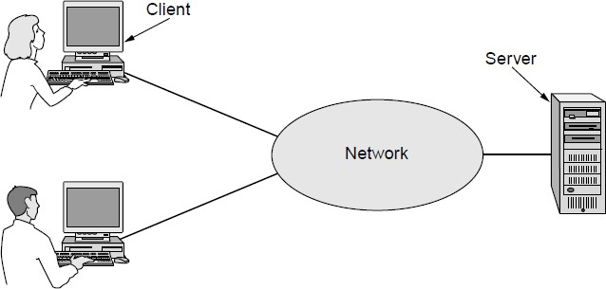
Business Applications
A network with two clients and one server

Slide 26
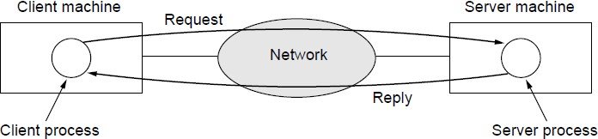
Business Applications (2)-The client-server model involves requests and replies.

Slide 27
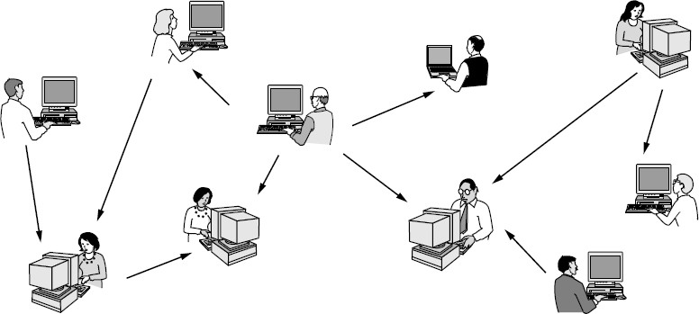
Home Applications (1)- In a peer-to-peer system there are no fixed clients and servers.

Slide 28
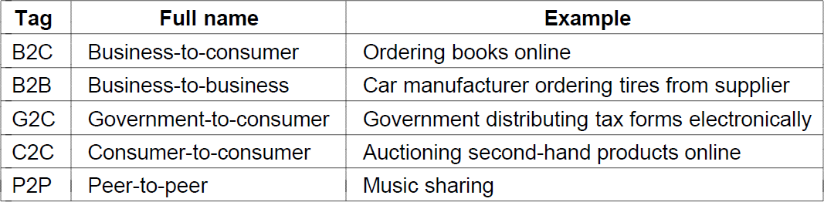
Home Applications (2)
Some forms of e-commerce

Slide 29
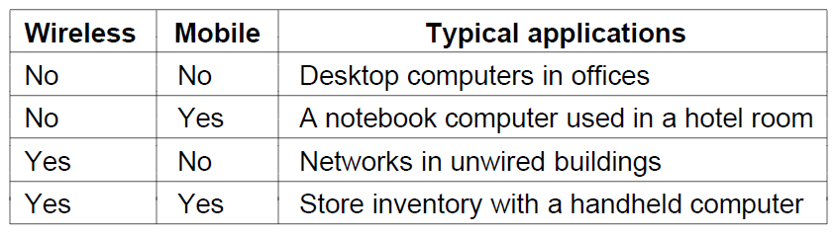
Mobile Users.
Combinations of wireless networks and mobile

Slide 30
Social Issues.
Network neutrality
Digital Millennium Copyright Act
Profiling users
Phishing

Slide 31
PROTOCOLS
A protocol is synonymous with rule. It consists of a set of rules that govern data communications. It determines what is communicated, how it is communicated and when it is communicated.
The key elements of a protocol are
Syntax
Semantics
Timing

Slide 32
Elements of a Protocol.
Syntax
Structure or format of the data
Indicates how to read the bits - field delineation
Semantics
Interprets the meaning of the bits
Knows which fields define what action
Timing
When data should be sent and what
Speed at which data should be sent or speed at which it is being received.

Slide 33
Types of Network.
Wired Networks
high bandwidth
low bandwidth variability
can listen on wire
high power machines
high resource machines
low delay
connected operation
Mobile Networks

Slide 34
Other Types of networks .
Mobile Networks
low bandwidth
high bandwidth variability
hidden terminal problem
low power machines
low resource machines
higher delay
disconnected operation

Slide 35


